Slide 1


FIFA World Cup Analysis

Slide 2
Problem Statement:
With FIFA is in the blood of many people of the world. You are tasked to tell the story of
unsung analysts who put great efforts to provide accurate data to answer every question of
fans.
The FIFA World Cup is a global football competition contested by the various football- playing nations of the world.
It is contested every four years and is the most prestigious and important trophy in the sport of football

Slide 3
Objectives:
To check frequency of goals in match.
To check winning possibility of team if they dominated on first half of a game.
To check top 5 players who played maximum matches in world cup.
To analyze public attendance in world cup matches.
Which city has hosted most number of matches?
Find probability of winning outcome of home team and away team.
Which country has the highest percentage of FIFA world cup?
What are the countries which managed to win a cup as a hoster of the tournament?

Slide 4
Details of Data:
Year
Date Time
Stage
Stadium
City
Home Team Name
Home Team Goals
Away Team Name
Away Team Goals
Win conditions
Attendance
Half time home goals
Half time away goals

Slide 5
Details of Data:
Referee
Assistant 1
Assistant 2
Round ID
Match ID
Team Initials
Coach Name
Line-up
Shirt Number
Player Name
Position
Event

Slide 6
Details of Data:
Year
Country
Winner
Runners-Up
Third
Fourth
Goals Scored
Qualified Teams
Matches Played
Attendance

Slide 7
Architecture:
Collect Raw Data → Importing Libraries → Load Dataset → Merging Data → Assessing Data → Handling Missing Data → Adding Columns → Exploring Data → Modeling → Creating Measures → Tableau Report → Insights

Slide 8
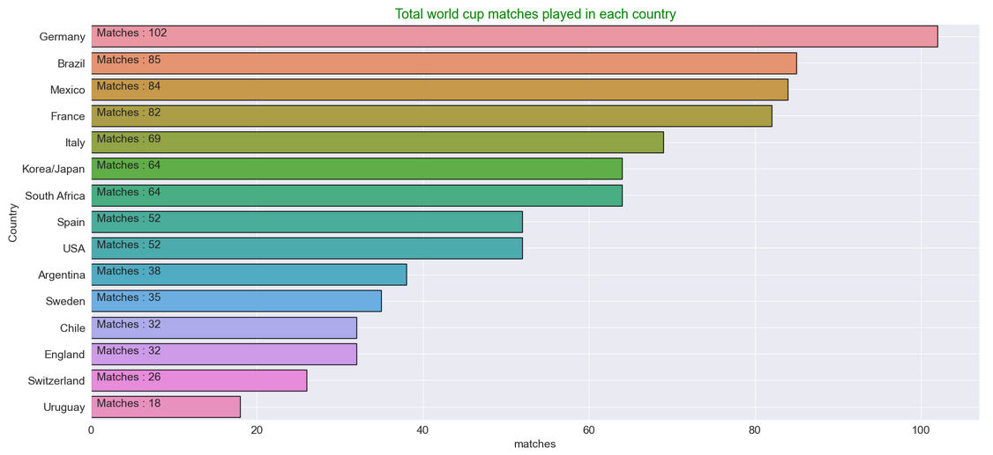
Some Important Insights:
Germany hosted maximum of number of matches.

Slide 9
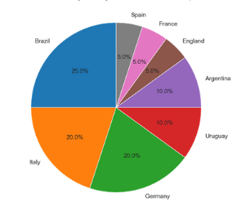
Some Important Insights:
Brazil has the highest time of FIFA world
cup wins.

Slide 10
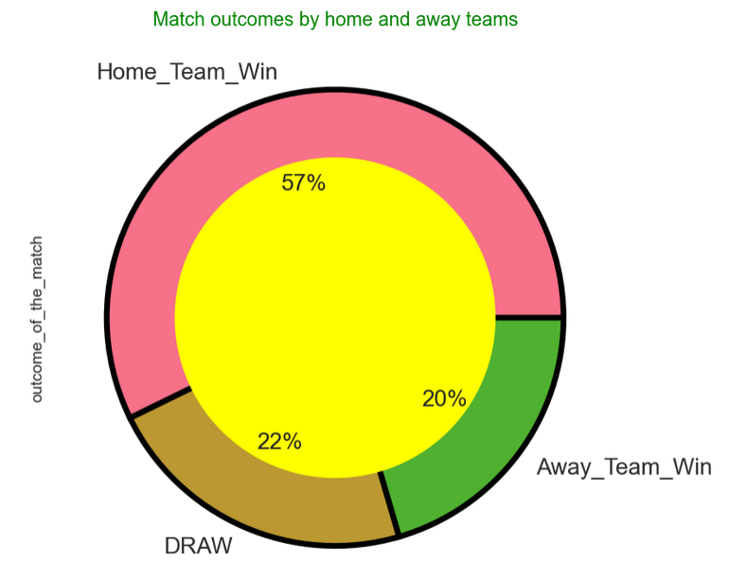
Some Important Insights:
57% of winning outcome of home team and 20% away team.

Slide 11
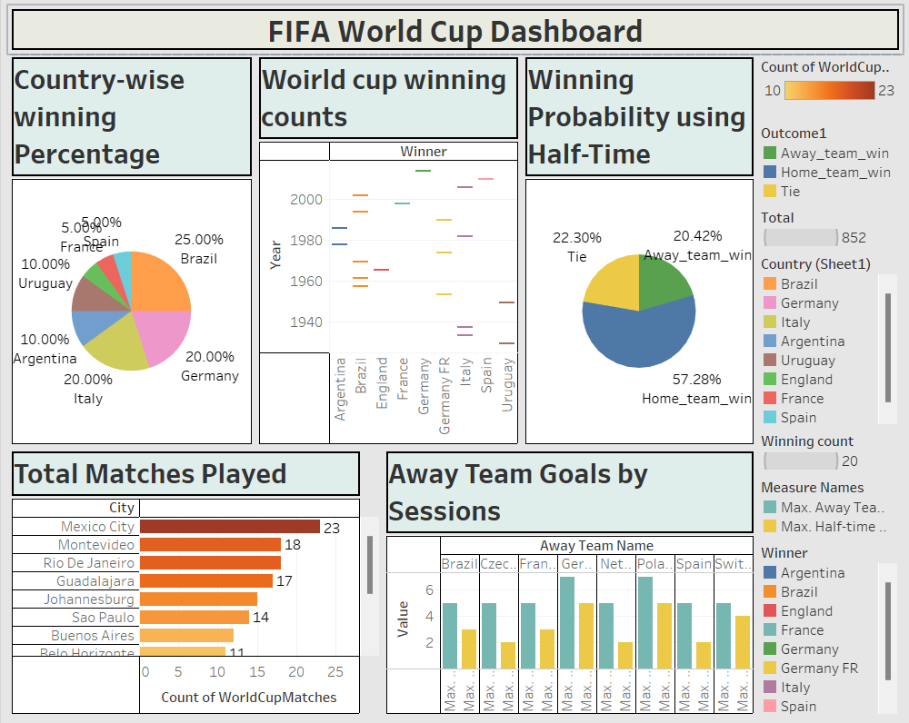
Dashboard:

Slide 12
Key Performance Indicator:
▪ Success rate by time
▪ Winning percentage by match
▪ Winning percentage by country
▪ Best players
▪ Number of games in each tournament
▪ Frequency of goals
▪ People attendance
▪ Hosted cities

Slide 13
Conclusion:
The first think we can draw from the above analysis and visualization is that the world cup started in 1930 and the first country that hosted the FIFA world cup is Uruguay which won Argentina on final. So Uruguay became the first country to win the FIFA word cup as hoster of the tournament Brazil is the first country holding the maximum number of FIFA world cup with 5 cups, followed by Germany and Italy both having 4 cups. Urguay and Argentina have 2 cups each, then England, France and Spain have 1 cups each. An Uzbek Ravshan IRMATOV holds the record for officiating the most FIFA World Cup matches with 9 matches, followed by QUINIOU Joel, LARRIONDA Jorge, ARCHUNDIA Benito with 8 matches each. Germany is leading the list of countries where played maximum number of matches, with 102 matches, followed by Brazil with 85 countries and Mexico with 84 matches A German player Klose is the one who breaked the record of playing maximum number of matches

Slide 14


Thank You.

